Slide 1


Santa Ana Unified School District
45 Day Budget Report
BOARD PRIORITY: Organizational Efficiency & Effectiveness
August 8, 2023
Notes:
Good evening President Torres, Members of the Board, Mr. Almendarez, and Education Partners throughout the Santa Ana Community.

Slide 2
Budget Timeline
Notes:
Multiple fiscal years
As we wrap up the current fiscal year, we are looking at estimated actuals.
Previously, 45-Day budget, first, second.
Next, come 7/1
Meanwhile, on the bottom half, the budget team has been busy with developing the 2023-2024 budget

Slide 3
Education Code 42127(h)(4)
Not later than 45 days after the Governor signs the annual Budget Act, the school district shall make available for public review any revisions in revenues and expenditures that it has made to its budget to reflect the funding made available by that Budget Act.

Slide 4
Additional Revenue in 2022-2023
The Budget Act reversed a large percentage of planned cuts in two block grants.
  Arts, Music, and Instructional Materials Block Grant
  Learning Recovery Emergency Block Grant
This impacts 2022-2023 revenue, as well as:
  2022-2023 ending fund balances
  MYP ending fund balances

Slide 5
Additional Revenue in 2022-2023

Slide 6
Expenditures
Arts, Music, and Instructional Materials Block Grant
  Must be expended by 2025-2026
  Budgeted Expenditures in 2024-2025 and 2025-2026
Overall net impact to MYP Ending Fund Balance = $13.8M

Slide 7
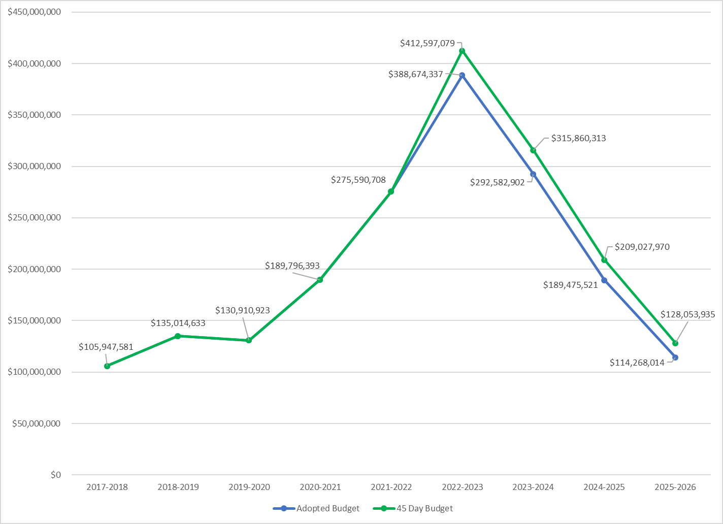
Ending Fund Balance

Slide 8

Thank you!
Questions?

